Slide 1
Software Engineering Project / MAIA Master
Group:
Antoine Merlet, Gülnur Ungan, Mladen Rakic, Marcio Rockenbach
Professors:
Dr. Yohan Fougerolle, Dr. Cansen Jiang, Dr. David Strubel

Slide 2
Table of Contents
Introduction
Choices / Target
Project Management
Results
Future Work
Conclusion
Statistics

Slide 3
Introduction
Context
Current state

Slide 4
Choices / Target
Organization of the code
Interfacing
Documentation
Variety of choices
GUI

Slide 5
Project management
Weekly meeting
Tasks splitting:
Sensor
GUI
Mahematics
Software Design & team leading
Collaborative tools

Slide 6
Software design
Code splitted meaningfully
Use of UML diagrams for:
Understanding
Documenting
Implementing

Slide 7
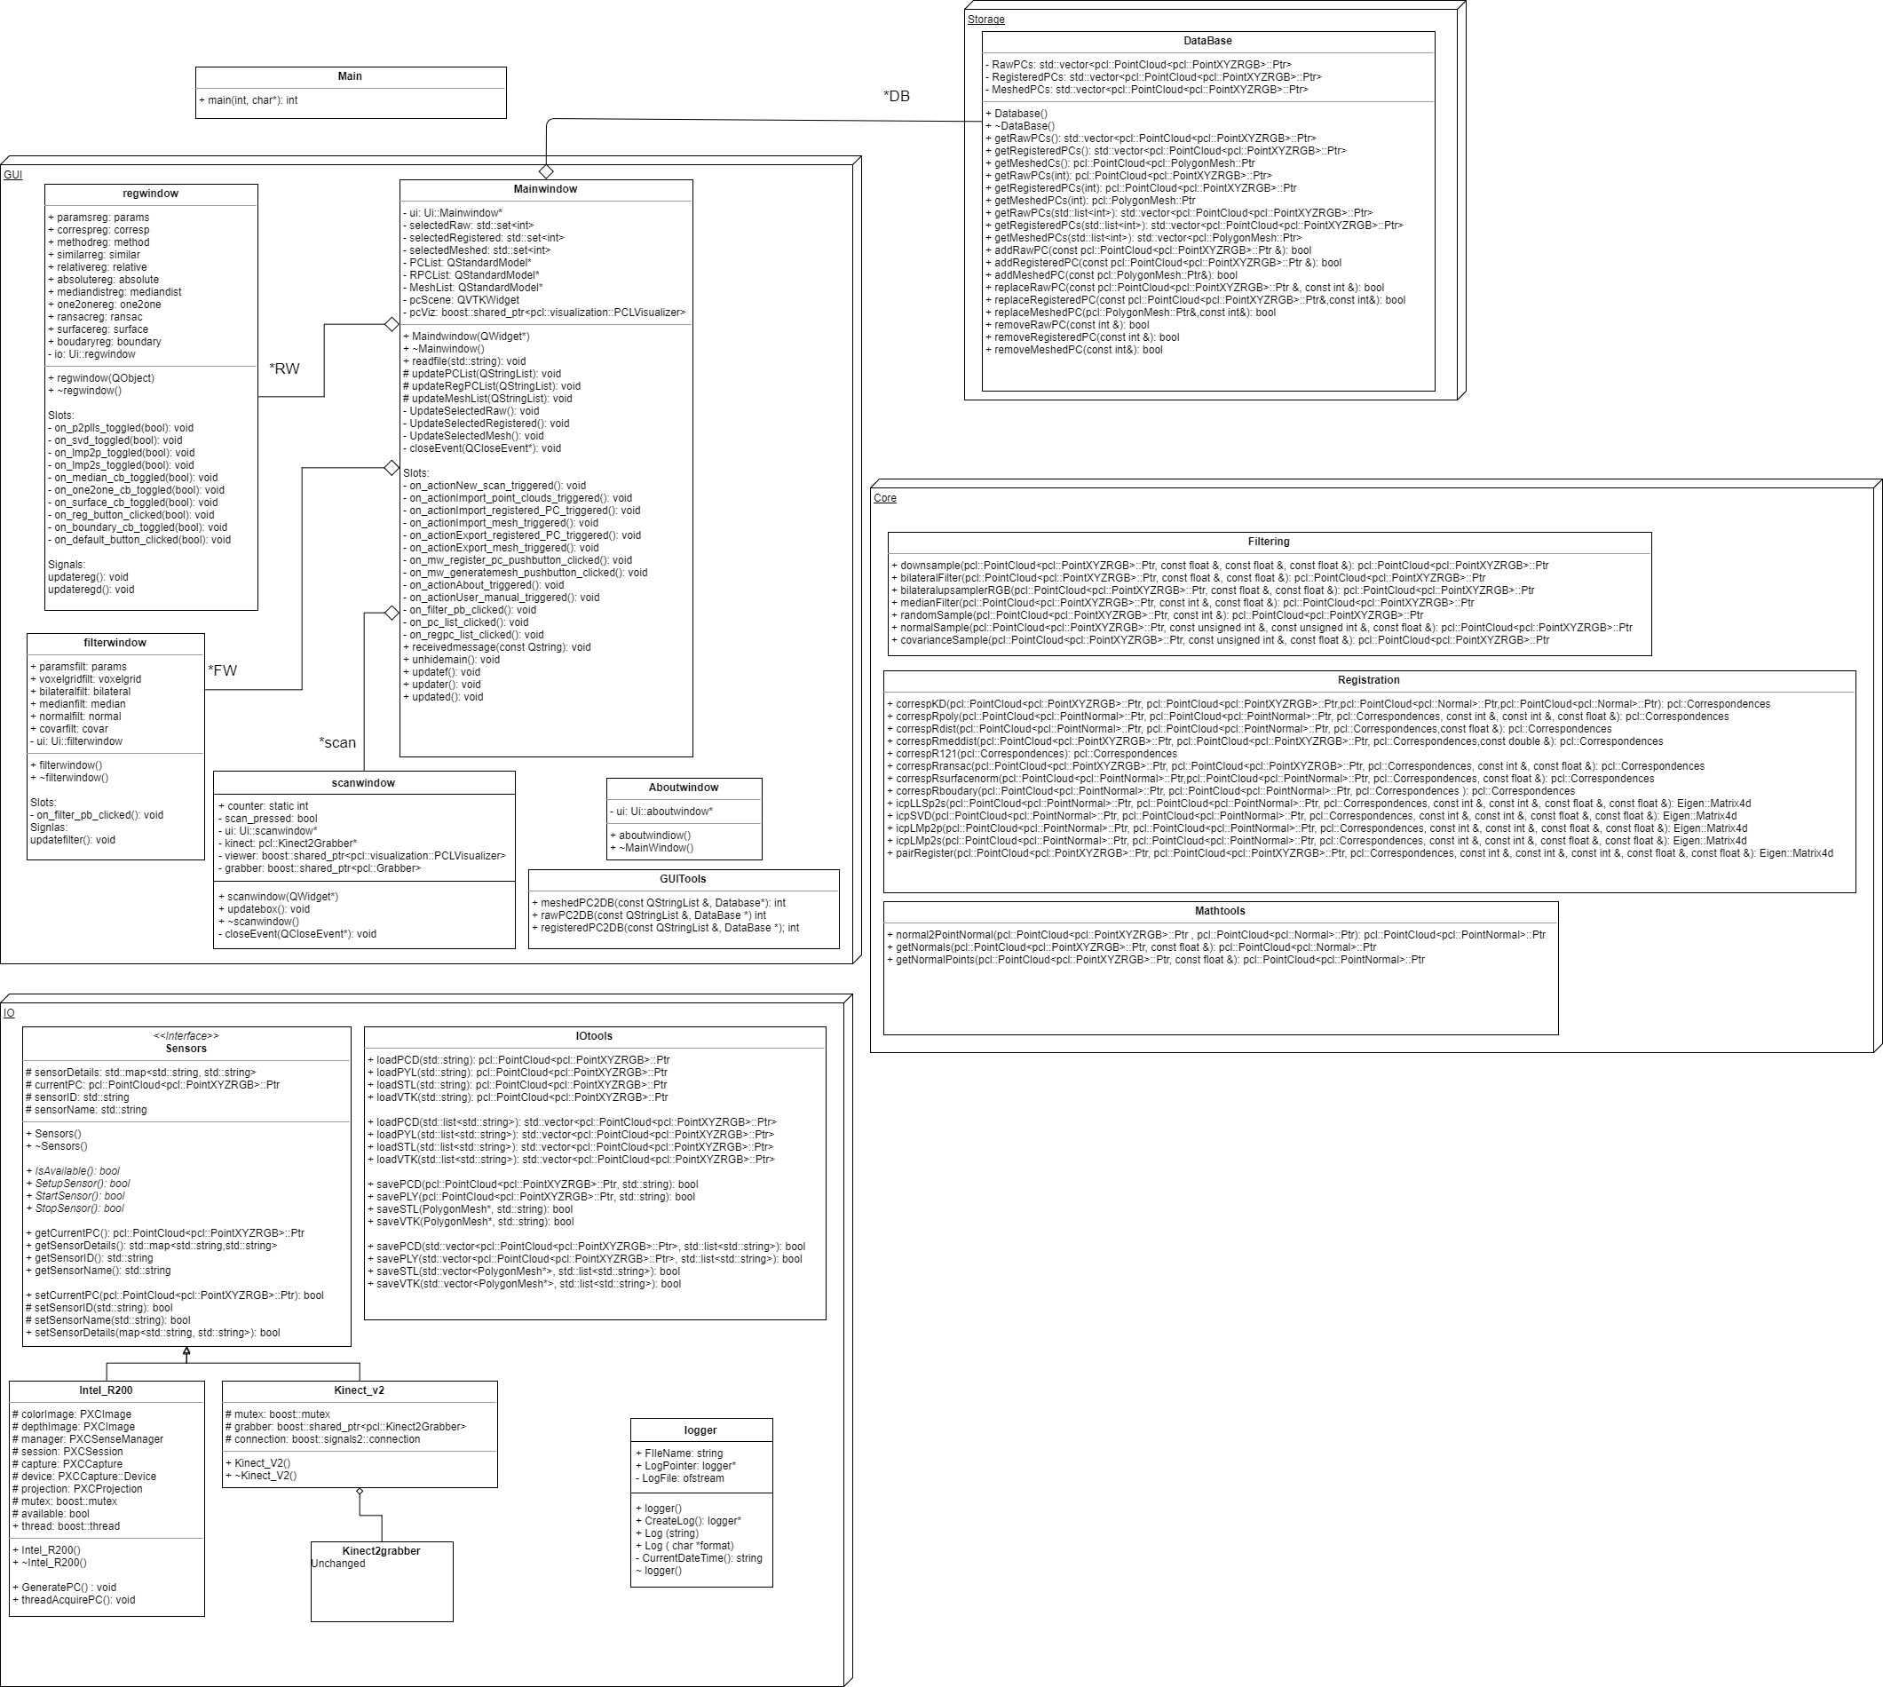

Slide 8
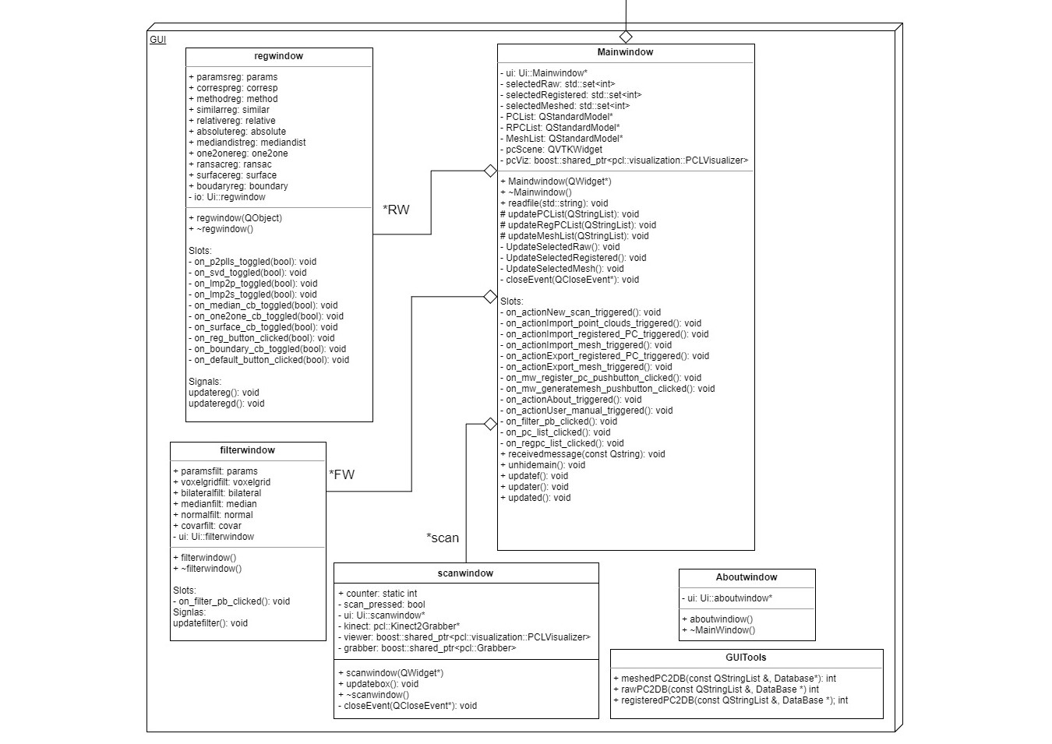

Slide 9
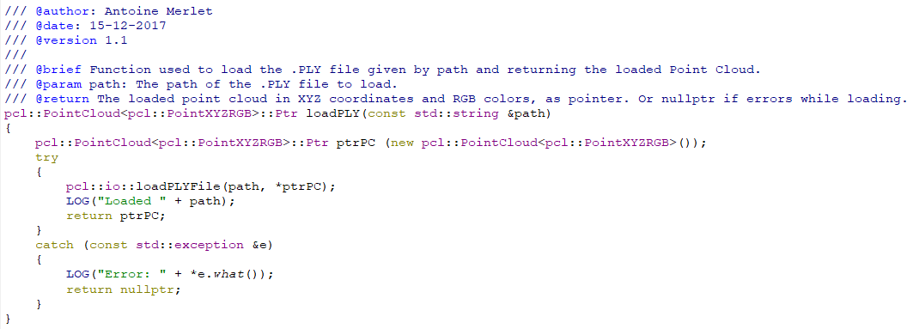
Coding habits

Slide 10
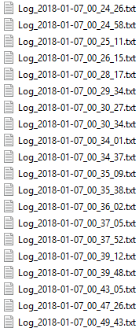

Logger
Debug feature
Singleton design
Signal / slots
Easiness of use

Slide 11
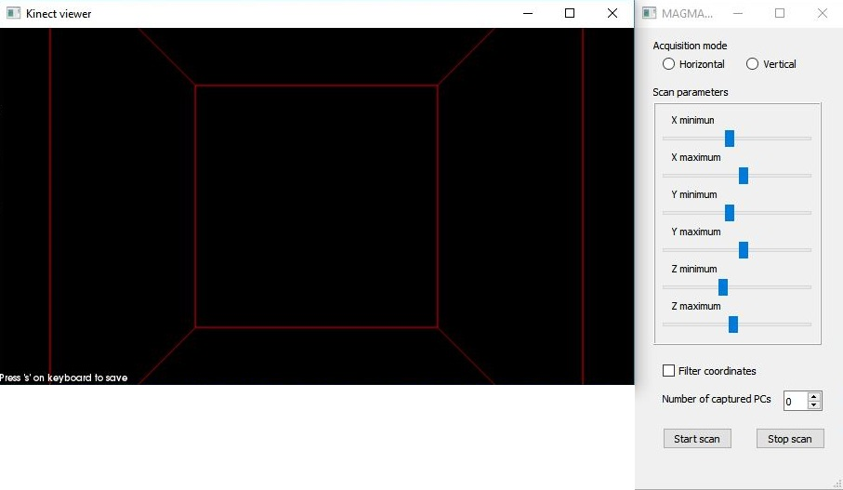
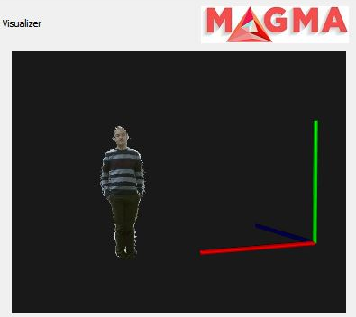
Input / Output
Kinect2grabber
Live Scan on PCL Visualizer Widget
Point cloud display on VTK Widget

Slide 12
GUI
Simplicity
Power
Diversity
Organization
Main window
Scan window
Filter window
Register window

Slide 13
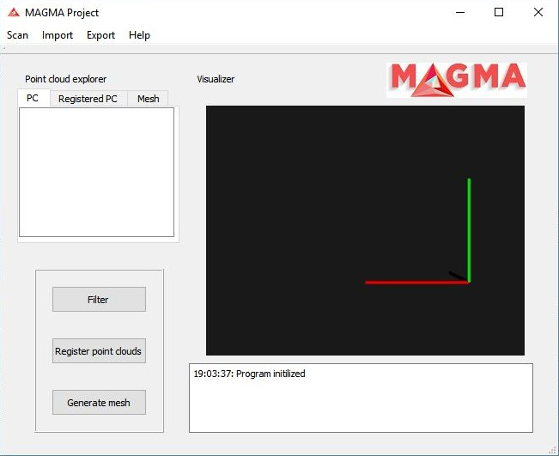
GUI – Main window

Slide 14
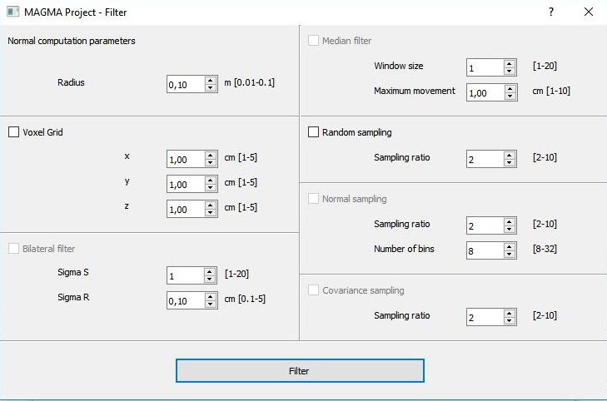
GUI – Filtering window

Slide 15
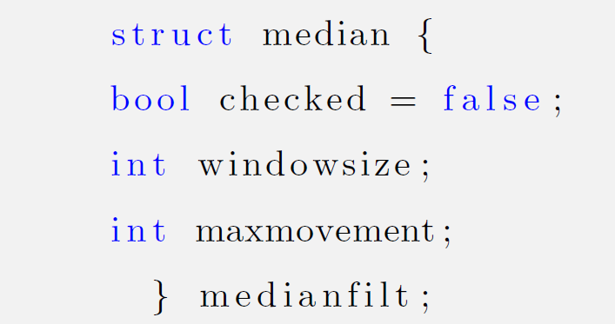
GUI – Example

Slide 16
Future Work
Meshing
Good parameters
Redirect std::cout to logger
Horizontal / Vertical acquisition modes
Configuration files
Full screen application
Functional bounding box
Integrate capture -> display point clouds
SQL database

Slide 17
Conclusion
Challenging Project
Focus:
- Perfect Software
+ Project design and coding habits
Results achieved
Good starting point for next year’s students

Slide 18
Thank you!

Slide 19
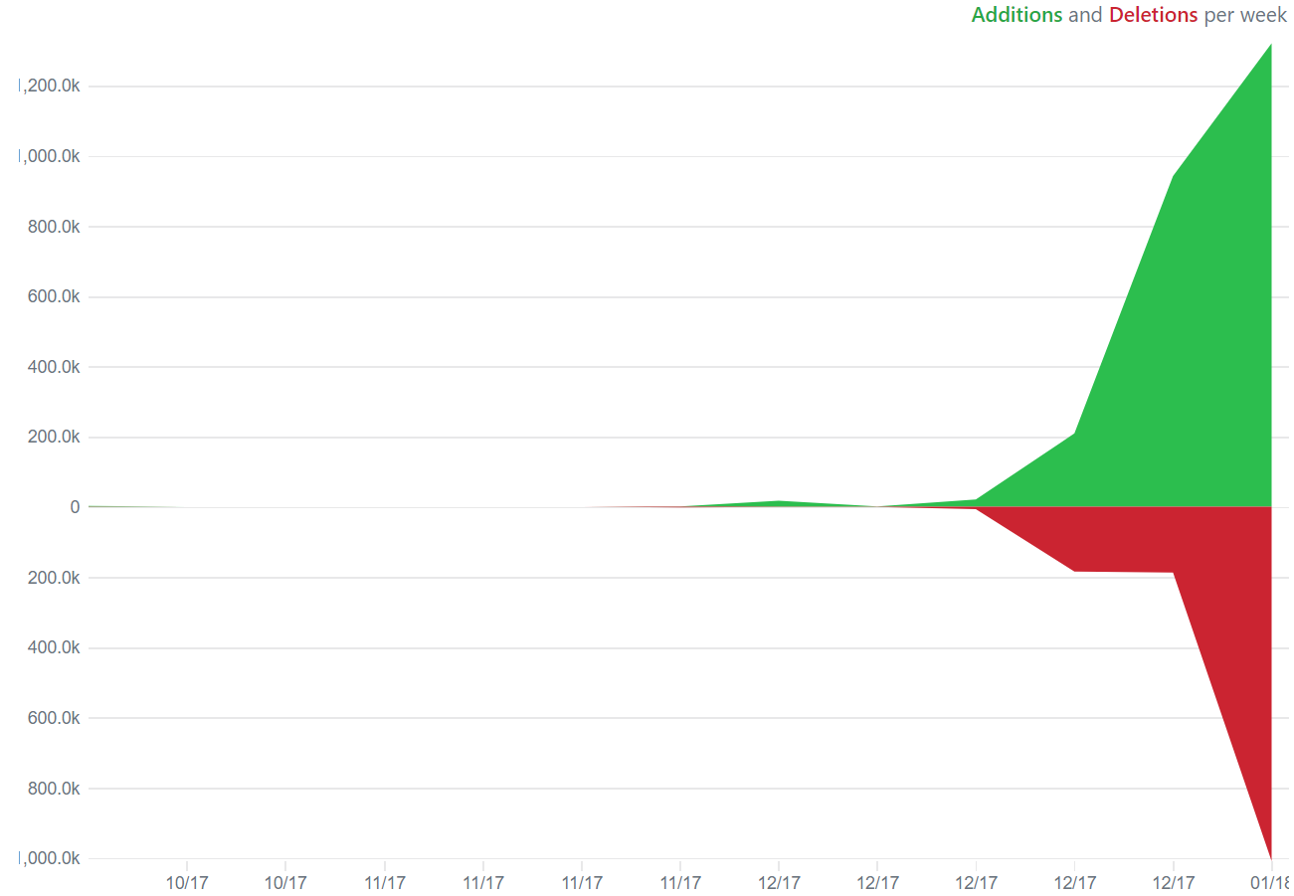
Q & A … and some Stats
Log files created in the last 2 days: 700
Commits: 165
Lines of code: 3748

